Slide 1
SPOTIFY RECOMMENDATION SYSTEM
BY
MAHENDRAKUMAR M

Slide 2
ABSTRACT
Spotify is the perfect example of the rise of music streaming services. The success of an app depends a lot on the user experience that the app provides to its users. A recommendation system is what helps a streaming application in providing a good user experience. So we can say that the Spotify Recommendation System has played a major role in providing a good user experience which has resulted in such success for Spotify. In this project a Spotify Recommendation System will be built using Machine learning algorithms like clustering analysis. Moreover Exploratory Data Analysis (EDA) will be carried out to gather some insights from the data.

Slide 3
1.Scope and Objective of the study
“Spotify Recommendation System” project belongs to audio-streaming services sector (Audio streaming Podcasting). Spotify is a Swedish audio streaming and media services provider founded on 23 April 2006.It is one of the world's largest music streaming service provider, with over 551 million monthly active users , including 220 million paying subscribers, as of June 2023. A recommendation system plays a major role in providing a good user experience in an application by recommending the most suitable and personalized services for each user. The data set has information about users and the songs listened by them. The objective of the study is to recommend songs to a user based on the songs listened by them. The Spotify recommendation system uses Clustering Analysis to recommend songs and podcasts to users.. So here we have built a machine learning project on Spotify Recommendation System using the Python programming language.

Slide 4
Data sources
Data contains the information about the users and the songs heard by them. The dataset contains the information like user id of the subscribers and the songs listened by the users.
Data Set Description:
Contains 1000 rows and 5000 columns
Analytics Tools
Tool: Jupyter Notebook.
Techniques: Unsupervised Machine Learning- K- Means Clustering.

Slide 5
2.Analytics approach:
Data cleaning and pre-processing is the initial stage of the project. As part of pre-processing exploratory data analysis will also be carried out to get a clear understanding of the data at hand, the attributes, the significance of the attributes, how each attribute are related to each other and to figure out the trends and patterns.
Since it is unsupervised machine learning we will do cluster analysis and collaborative filtering to build a recommendation system.Collaborative filtering recommends products or services by finding similarities between users and the products or services to provide a better user experience. It works by searching a large group of people and finding a smaller set of users with tastes similar to a particular user.

Slide 6
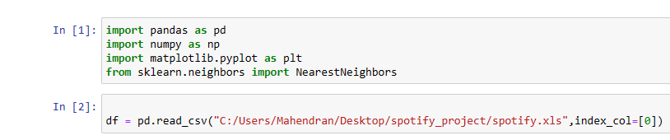
3.DATA PREPARATION AND UNDERSTANDING
Importing required libraries and the dataset

Slide 7
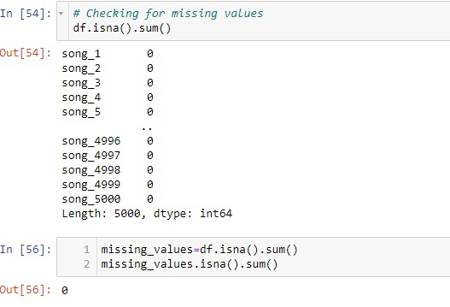
3.1 MISSING VALUE TREATMENT
We can see that there are no missing values in the data so we can proceed further and check for any outliers in the dataset.

Slide 8
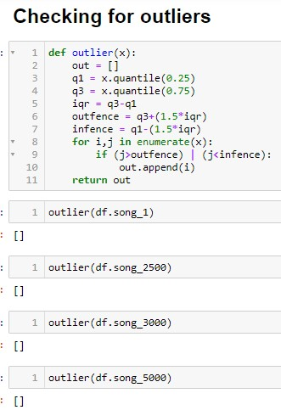
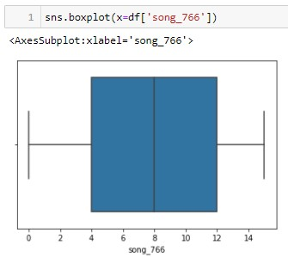

3.2 Handling Outliers

Slide 9
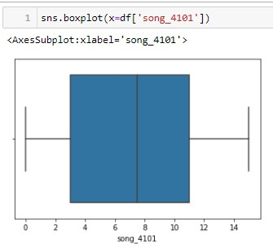
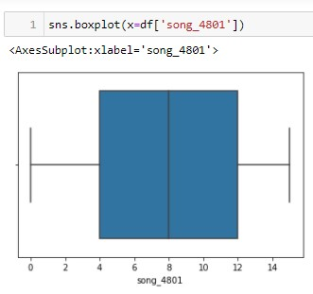
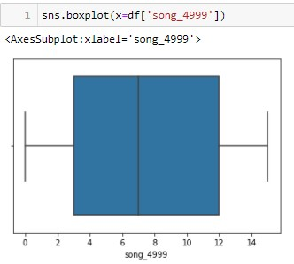
We could not find any outliers in the dataset which could impact would affect our model. Less number or no outliers in many variables as compared to the huge number of observations whose effect will be negligible.

Slide 10
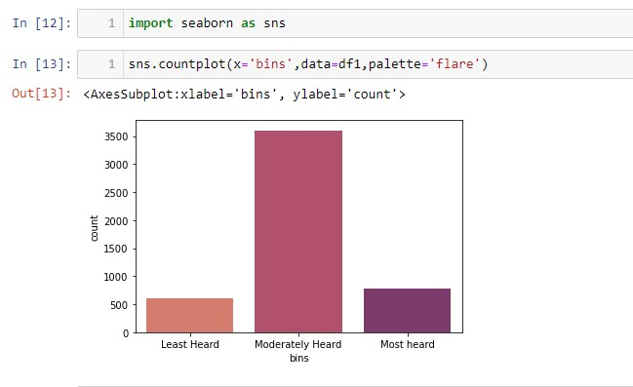
4.Exploratory data analysis(EDA)
The songs can be split into three categories most heard ,least heard and moderately heard based on the maximum value and minimum value of the total number of times the songs have been heard. Here from the above plot we can see that moderately heard songs are more than the other two categories.

Slide 11
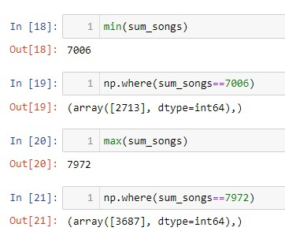
The song_3688 is the most listened song and the song_ 2714 is the least listened song by the users among all 5000 songs.

Slide 12
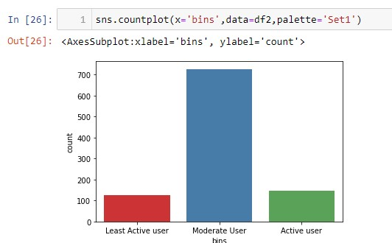
We have split the users into three categories active users, least active user and moderate user based on the total number of times they have heard the songs.
Here also we can see that moderate users are more in number compared to active users and least active users.

Slide 13
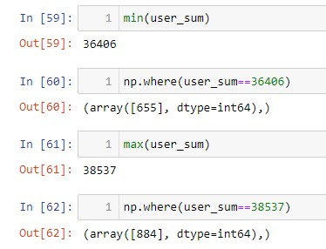
The user_656 is the most active user and user_885 is the least active user based on the number of songs heard by all the 1000 the users.

Slide 14
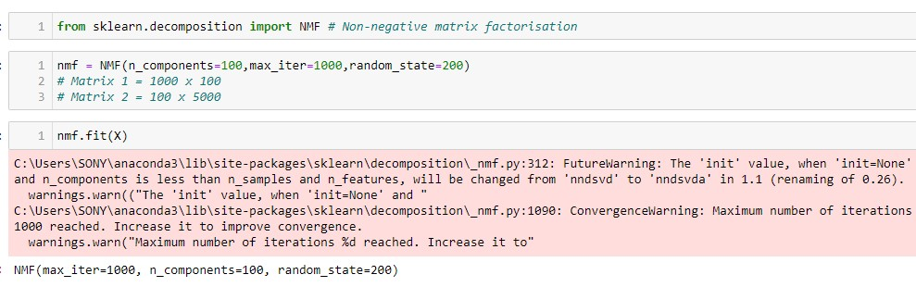
5. FINAL MODEL
We have converted our data frame into a sparse matrix in order to apply Nonnegative Matrix Factorization .

Slide 15
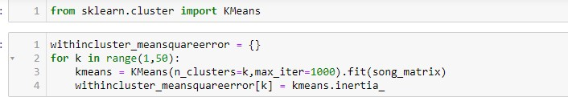
Properties of Nonnegative Matrix Factorization (NMF) as a clustering method are studied by relating its formulation to other methods such as K-means clustering.. By introducing sparsity constraints on the coefficient matrix factor in NMF objective function, we in term can view NMF as a clustering method.

Slide 16
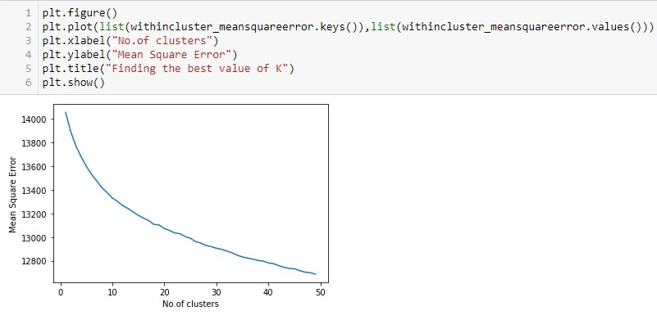
Elbow method : In cluster analysis, the elbow method is a heuristic used in determining the number of clusters in a data set

Slide 17
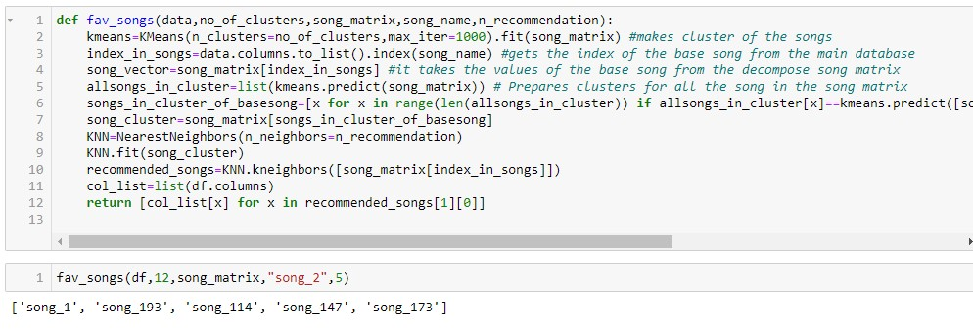
The recommendation system will recommend any number of songs (say 1 t0 5000) to any user based on a song they have heard .

Slide 18
6. CONCLUSION
We have built a Recommendation model to the users of the spotify . The spotify dataset was not labeled so we have used an unsupervised machine learning technique which is cluster analysis along with collaborative filtering to build a recommendation system which will recommend songs to each individual user distinctively.
We have found after analysing that with K-means clustering we could build an recommendation system which gives impressive recommendations for the users in the spotify dataset.

